Slide 1









MedIQ.AI
Symptoms to disease at your fingertips.
Group Members -
Aryan Sharma (102119058)
Amteshwar Singh (102119063)
Aayush Arora (102119050)
Naman Sharma (102119042)
Tushar Kr. Garg (102119040)
Mentor - Mr. Dharmendra Kumar

Slide 2

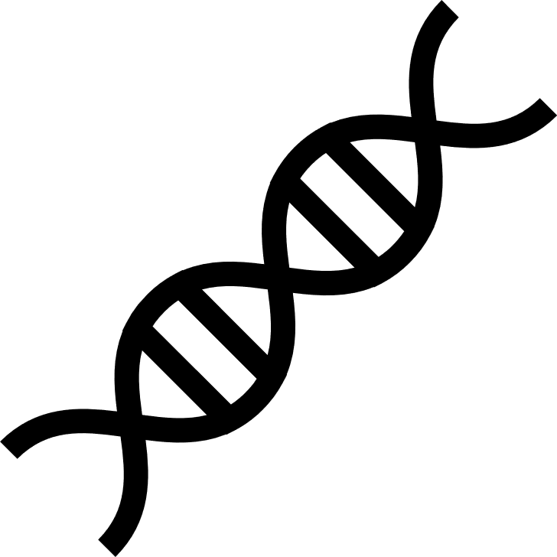

Table of contents
1
Problem Statement
2
Use Cases
3
Literature Survey
4
Need Analysis
5
Assumptions & Constraints
6
Objectives
7
Deliverables
8
Workflow Diagram
9
Expected Outcomes
10
Requirement/Tools
11
Innovation and Originality of our Solution
12
Implementation Summary
13
Work done so far
14
References

Slide 3
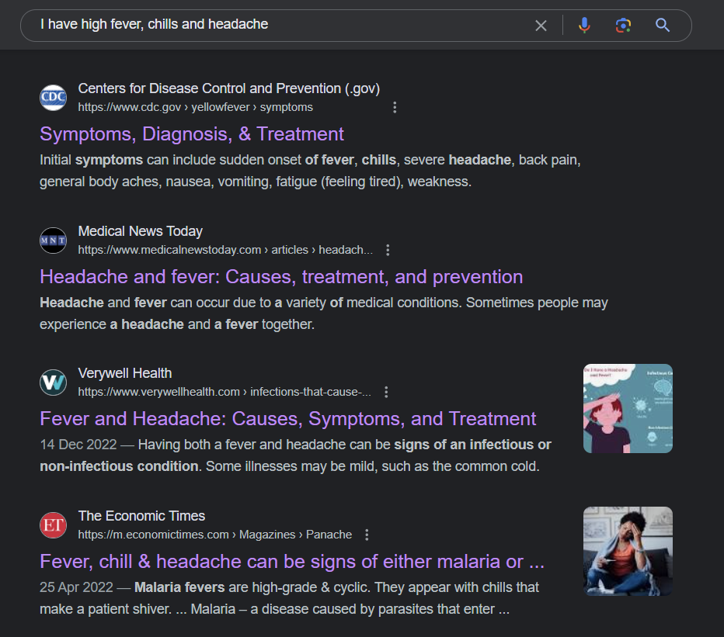

Problem Statement
Yellow fever virus
From healthcare research point of view
From a societal point of view
Meningitis, Flu, Sinus infection, Heatstroke, Cancer
Meningitis, Encephalitis, Flu, Brain Abscess, Sinus Infection, Heatstroke, Rheumatoid Arthritis,
HIV or AIDS, Lupus
Malaria or Covid
Fig. 1 : Google search on entering the symptoms
Notes:
Pointwise
1 - Research aspect - not yet made
2- social aspect (instead of going to Google, they can use this app)
(image)

Slide 4
Use Cases
Remote Health Monitoring
Symptom Checker for Undiagnosed Conditions
Public Health Initiatives
Research Participation

Slide 5
Literature Survey
Study Authors | Focus Area and Methodology | Data Type | Key Findings | Limitations/Research Gaps
Litjens et al. (2017) | Medical image analysis via Convolutional Networks | Medical images | Reviewed over 300 contributions, highlighting deep learning's application in image classification, object detection, and more. | Not disease prediction specific, focuses broadly on imaging.
Rajkomar et al. (2018) | Predictive modeling with EHR via Deep Learning, FHIR format | Electronic Health Record (EHR) data | Deep learning models accurately predict medical events without site-specific data harmonization. | Focused on in-hospital metrics, broader application needed.
Bychkov et al.(2018) | Colorectal cancer outcome prediction via Convolutional and recurrent architectures | Images of tumour tissue samples | Deep learning-based prediction outperforms human experts in risk stratification. | Limited to colorectal cancer, application to other cancers or diseases is necessary.
Wu et al.(2018) | Disease status prediction using genomic data via Auto-encoders, Machine Learning | Genomic data | Deep learning approaches outperformed existing prediction methods using genomic data. | Limited genomic data types considered, broader data incorporation needed.
Notes:
10 papers

Slide 6
Literature Survey
Usama et al.(2019) | Disease prediction using clinical text via Self-attention based RCNN | Clinical text data | Improved accuracy for cerebral infarction disease prediction. | Focused on infarction, may need adaptation for other diseases.
Liu et al.(2019) | Deep learning vs health-care professionals in detecting diseases via DL | Medical imaging | Deep learning models equivalent to health-care professionals in diagnostic accuracy. | Comparison in specific tasks, broader comparison across various diseases needed.
Rebane et al.(2020) | Adverse drug event prediction via Temporal attention mechanisms, decay factors | Clinical text and EHR data | Improved ADE prediction using interpretable deep learning models. | Limited to ADEs, potential for broader application.
Mishra and Tarar(2020) | Chronic Disease Prediction via K-nearest neighbor, decision tree, deep learning (RELU, sigmoid activation function, deep sequential network) | Standard dataset | Deep learning algorithms predict chronic diseases. | Specific to chronic diseases, adaptation for acute conditions or broader health issues may enhance utility.
Notes:
10 papers

Slide 7
Literature Survey
Men et al.(2021) | Multi-disease prediction via LSTM | Clinical visit records | Utilized LSTM for enhanced clinical decision support through multi-disease prediction. | Specific to clinical visit records, may require more diverse data types.
Lalithadevi and Krishnaveni (2022) | Disease risk prediction | Various (Diabetes, breast cancer, COVID-19) via ANN, CNN | ANN and CNN models achieve higher accuracy than machine learning models. | Focused on specific diseases, may not generalize.
Seng-Keong Tan et al. (2024) | Utilizes AI models for symptom diagnosis and hospital recommendations using location-based services | Personal health records, medical history, allergies, and user location data | User-friendly system for personalized healthcare management, symptom diagnosis, and hospital recommendation. | Lacks real-time implementation and validation across diverse user scenarios. and does not evaluate long-term user engagement.
Moh Heri Kurniawan et al. (2024) | Review of artificial intelligence (AI)-driven chatbots in managing chronic illnesses. | Qualitative data gathered from multiple studies and articles on AI chatbot interventions. | AI-powered chatbots can improve patient adherence to treatment, provide real-time monitoring, and enhance patient outcomes in chronic illness management. | Limited empirical evidence on long-term effectiveness and user acceptance in real-world applications​
Notes:
10 papers

Slide 8
Literature Survey
Manali Jain et al. (2024) | Uses NLP to process user input, store responses in a database, and respond based on a decision-making system. | Patient symptom data collected via chatbot interactions. | Offers a quick, cost-effective way to diagnose basic health conditions and provide recommendations. The integration of AI and NLP improves healthcare accessibility. | The system currently does not include voice input features and lacks integration with more sophisticated health monitoring tools like sensors.
Min Chen et al. (2024) | Involves a CNN-based multimodal disease risk prediction (CNN-MDRP) algorithm that processes both structured and unstructured data from hospital records. | Uses a dataset of 31,919 patients from central China, consisting of structured and unstructured data from electronic health records. | The proposed CNN-MDRP model achieves a prediction accuracy of 94.8% for high-risk cerebral infarction patients. | The model needs further testing on other diseases and in different geographical regions.
Md Naseef-Ur-Rahman Chowdhury et al. (2023) | It compares different algorithms like Decision Trees, Random Forest, and Support Vector Machines (SVM) to evaluate the effectiveness in predicting diseases | Symptom-based data derived from patient health records | The study finds that Decision Tree algorithms outperform others, offering higher accuracy for disease prediction based on symptoms. | The dataset size was relatively small, and the research points out the need for larger datasets for more reliable predictions.
Notes:
10 papers

Slide 9
Literature Survey
Sameer Dev Sharma et al. (2023) | The study employs a web-based framework using the Python Django framework to allow specialists to upload images for diagnosis. | Achieved a 95% accuracy rate in diagnosing various skin conditions.The CNN model, particularly DenseNet169, outperformed other models. | Offers a quick, cost-effective way to diagnose basic health conditions and provide recommendations. The integration of AI and NLP improves healthcare accessibility. | The study is limited to a specific dataset of skin disease images, which may not encompass all possible variations in real-world scenarios.
Uday Kiran Kommineni et al. (2023) | Utilizes a GUI built using Python and the Tkinter library, where users input symptoms using uses Random Forest and Naive Bayes algorithms. | A preprocessed dataset containing 133 attributes, including 132 symptoms and one prognosis, in binary format | The Random Forest algorithm achieved a prediction accuracy of 97.29%, while the Naive Bayes algorithm showed an accuracy of 97.11%. | It can predict limited number of diseases.. Additionally, the dataset used is limited to specific symptoms and conditions.
Mahender Singh et al. (2024) | Study investigates various AI chatbot implementations in healthcare, emphasizing natural language processing (NLP | Secondary data from existing literature, case studies, and examples of AI chatbot applications in healthcare settings. | AI chatbots can enhance healthcare accessibility and efficiency by providing pre-diagnosis, patient engagement, and support in various healthcare domains | Current limitations include the inability of chatbots to express empathy, recognize emotional states, or provide tailored responses, which affects their acceptance in sensitive healthcare contexts
Notes:
10 papers

Slide 10
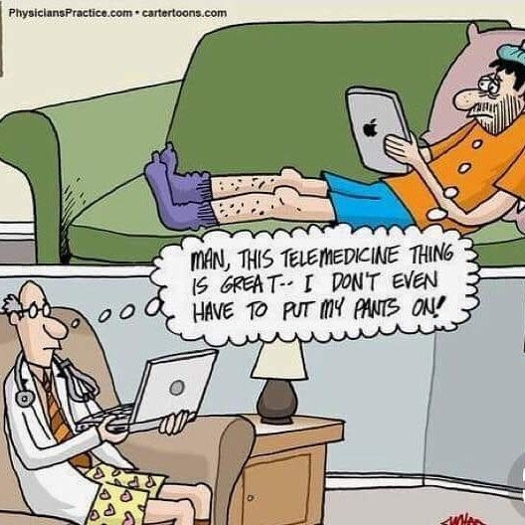
Need Analysis
Accessibility of Medical Information
Early and Accurate Disease Identification
Reduction of Information Overload
Fig. 2 : A meme explaining the need of our model .
Source: Adapted from [19]

Slide 11
Assumptions and Constraints
Assumptions
.
Users accurately and thoroughly describe symptoms.
Access to a diverse dataset for training on disease prediction and doctor recommendation.
User consent for health information sharing aligns with privacy and ethical standards.
Constraints
Limited Training Data for Rare Diseases
Interpretability of Layman Language
Real-Time Processing Limitations
Resource Intensiveness of Deep Learning
Legal and Ethical Considerations
Notes:
Elaborate assumptions

Slide 12
Objectives
O-1
Deep Learning based recurrent model for symptom summarization
O-2
Develop a symptom database from various sources, such as Mayo Clinic, standardized to meet model requirements.
O-3
Build a symptom-based doctor recommender considering proximity, specialisation & availability.
Notes:
Objective - 4 (Tentative)

Slide 13
Deliverables
Website
Application
Secure Database Infrastructure
Notes:
Based on the dataset we will see which model will suit the best

Slide 14
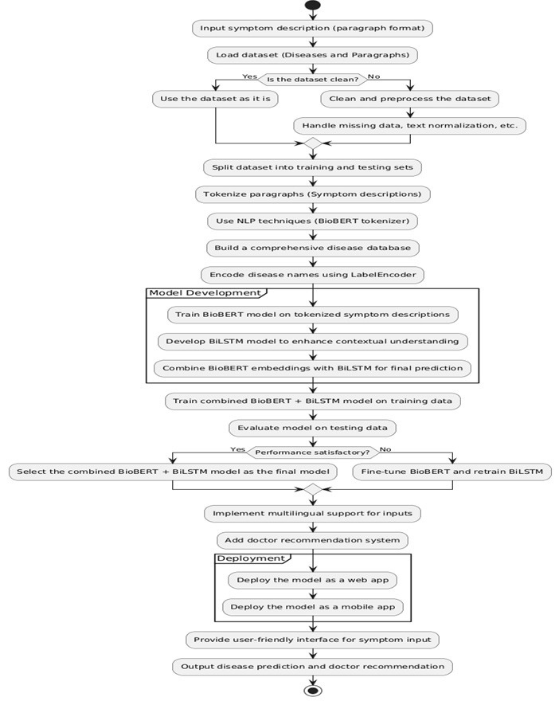
Workflow Diagram
Notes:
Include examples of Dataset

Slide 15
Notes:
Include examples of Dataset

Slide 16
Expected Outcomes
A user-friendly interface
Personalized Doctor Recommendations
Improved Patient-Doctor Communication
Streamlined Medication Management
Contributions to Medical Research
Efficient Healthcare Resource Utilization
Notes:
Reduce to 3-4 points

Slide 17
Tools
Frontend Development
HTML, CSS, JS
Bootstrap
Flask
Backend Development
Node.js
MongoDB
Deep Learning Framework
TensorFlow 2.0
User Authentication:
OAuth or JWT-based authentication system for secure user login and authentication.
Model Deployment:
Firebase

Slide 18
Innovation and Originality of our Solution
Natural Language Understanding
Database
Expanding Input Flexibility

Slide 19
Implementation Summary
Data Acquisition and Preparation:
We assemble a large dataset comprising textual descriptions of symptoms.
This data is meticulously cleaned and formatted to train our models effectively.
Model Development and Integration:
Using BiLSTM layers to create a text summarization model.
This allows for a more accurate and efficient analysis.
We tried and tested various models like T5, GAN, GNN, and Autoencoder and, in the end, employed the BioBERT model and BiLSTM layers to establish a benchmark.

Slide 20
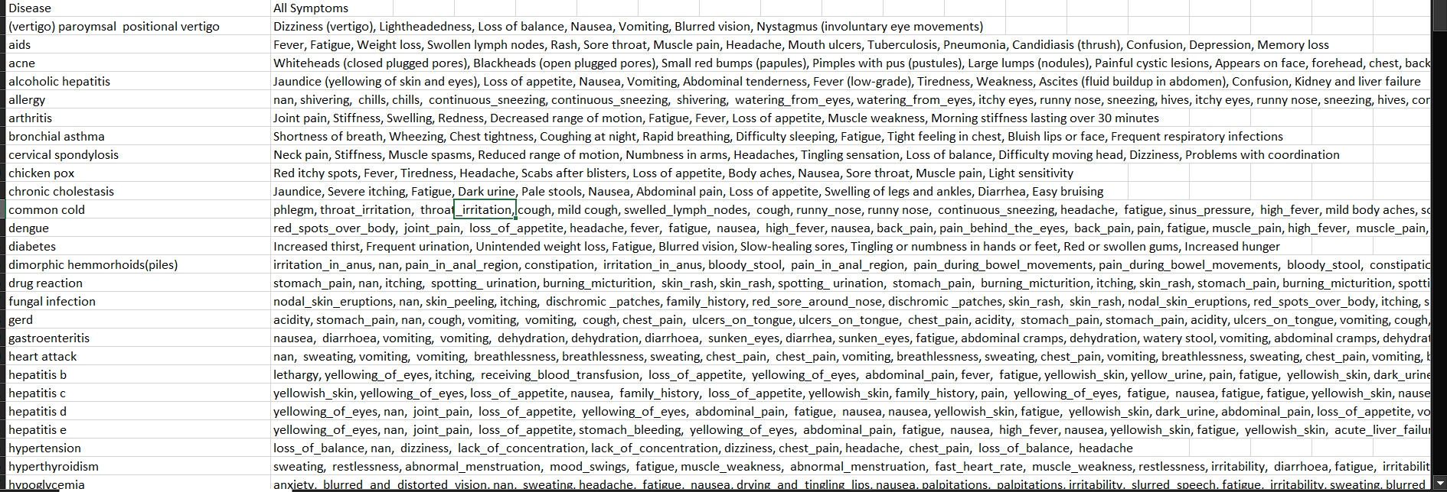
Work Done so far
Fig. 3: Diseases with Symptoms Database

Slide 21
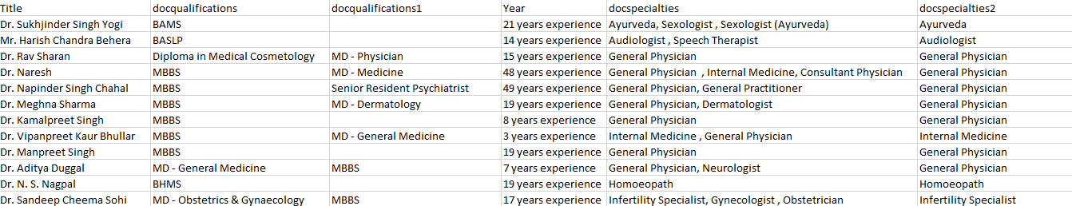
Work Done so far
Fig. 4: Doctors Database

Slide 22
Work Done so far
Expanded our database to 350 diseases.
Trained our model entirely from scratch using BioBert and BiLSTM, ensuring it learns patterns specific to our dataset.
Employed pre-trained models, such as BERT, T5, Generative adversarial network (GAN), Auto Encoder and Graph neural network (GNN), to establish a benchmark for comparison on the same dataset.

Slide 23
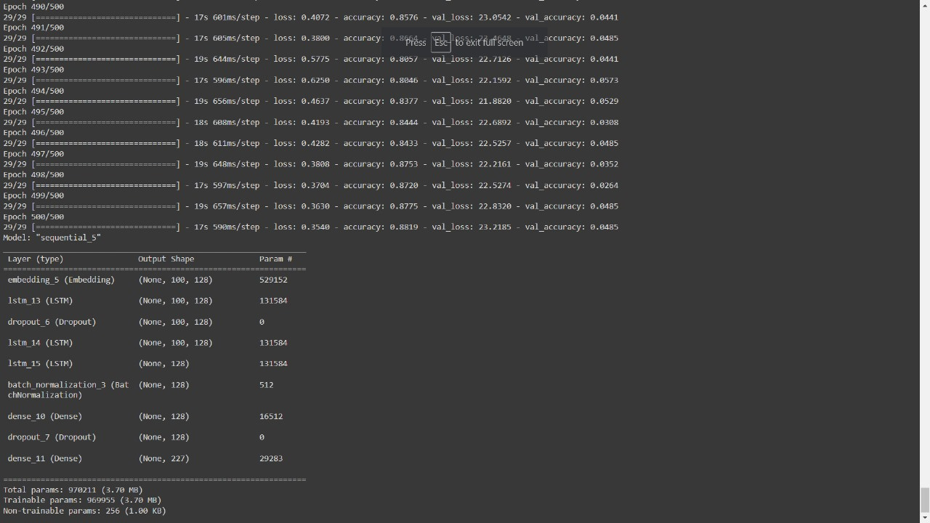
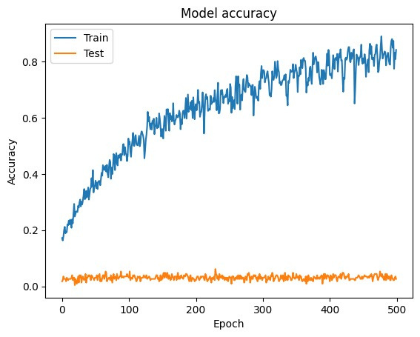
Work Done so far
LSTM Model
Fig. 5: Model Summary of LSTM
Fig. 6: Accuracy of the LSTM Model

Slide 24
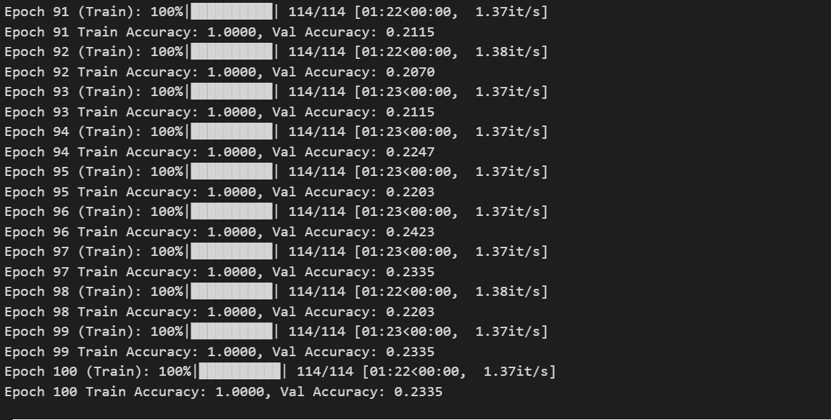
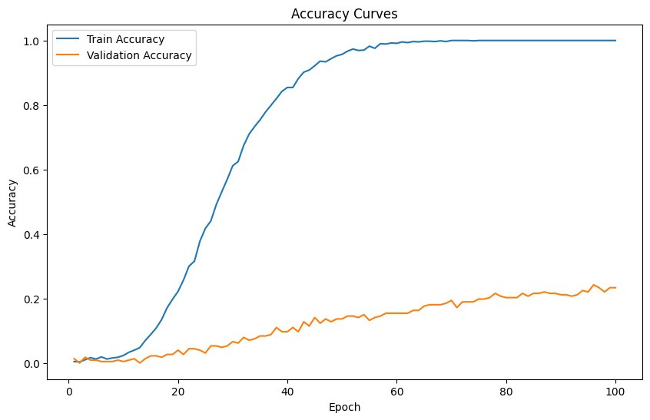
Work Done so far
BERT Model
Fig. 7: Accuracy of the BERT Model

Slide 25
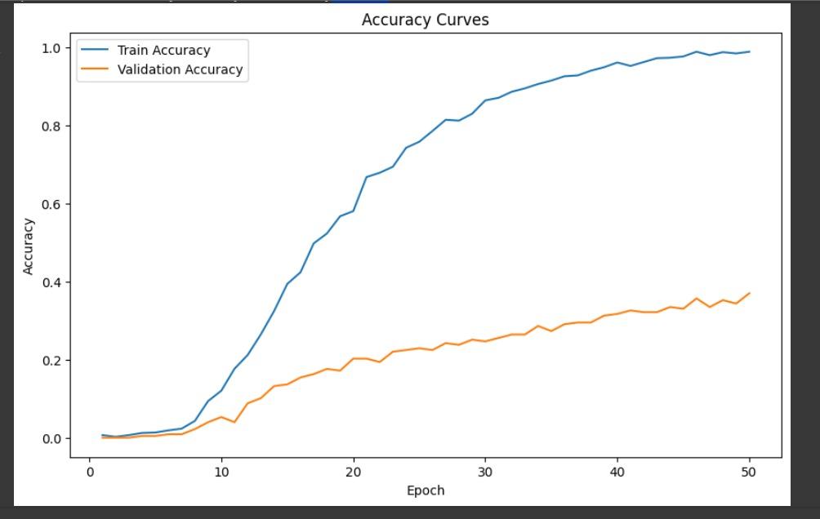
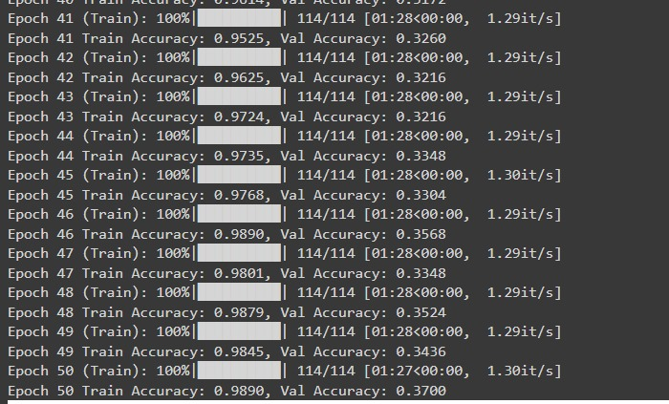
Work Done so far
T5 Model
Fig. 8: Accuracy of the T5 Model

Slide 26
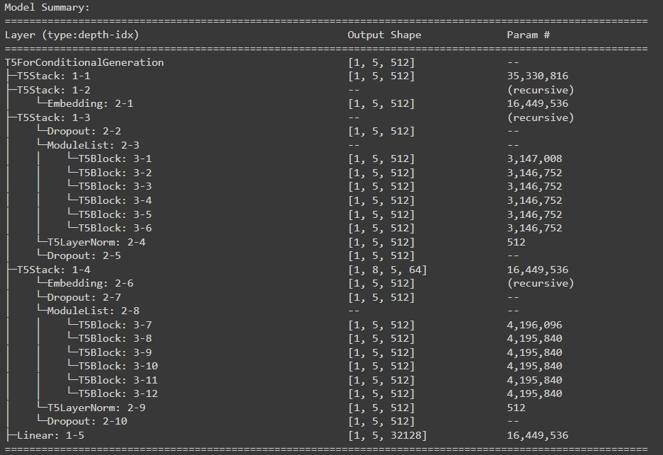
Work Done so far
Fig. 9: Model Summary of the T5 Model

Slide 27
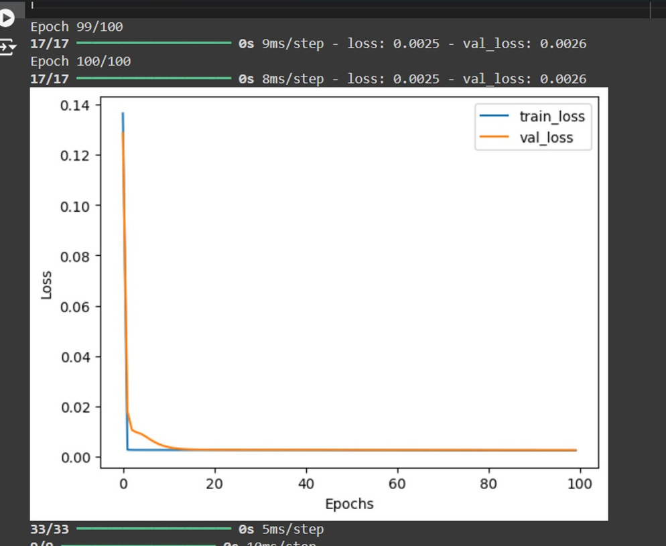
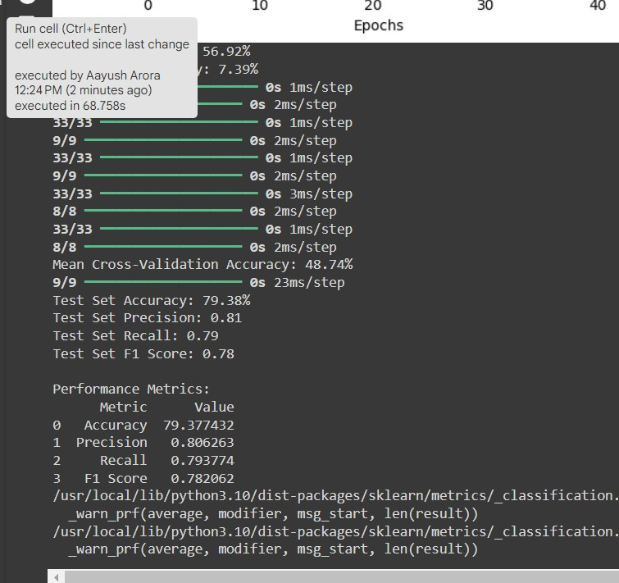
Work Done so far
Auto Encoder Model
Fig. 10: Accuracy of the Auto Encoder Model

Slide 28
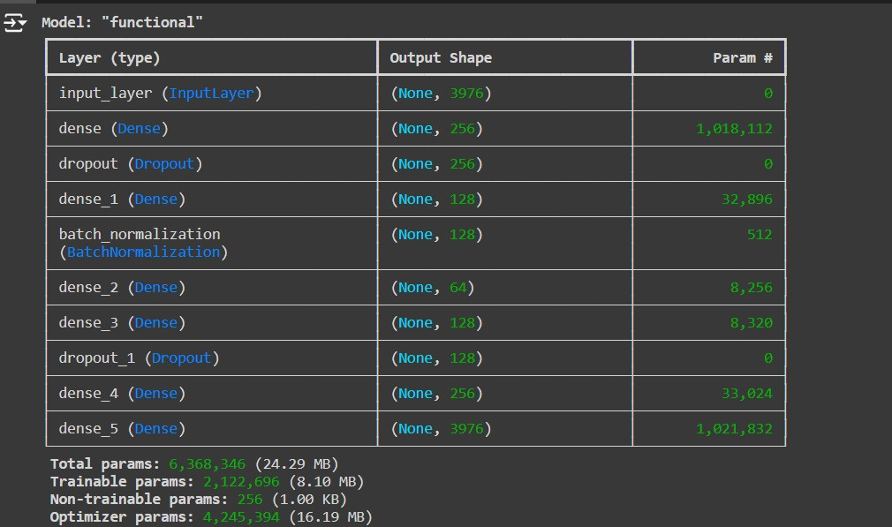
Work Done so far
Fig. 11: Model Summary of the Auto Encoder Model

Slide 29
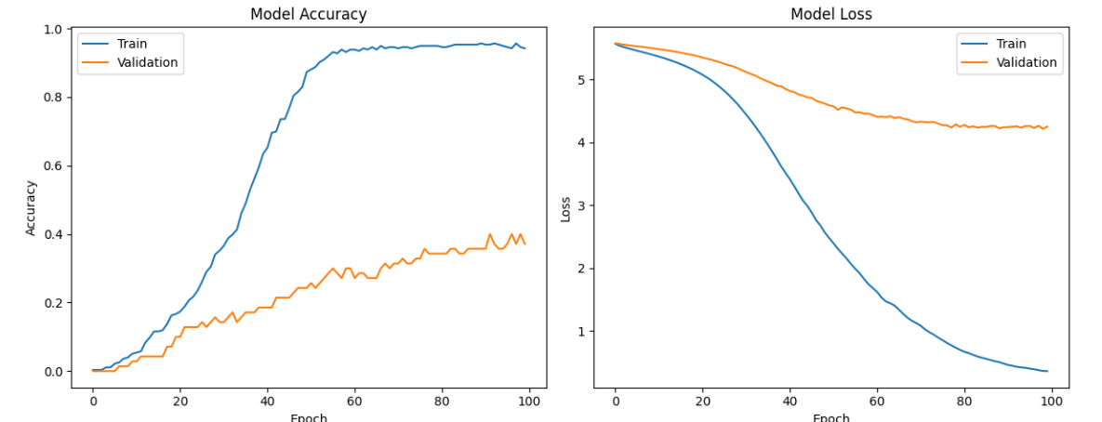
Work Done so far
LSTM Model with updated dataset
Fig. 12: Accuracy of the LSTM Model (updated dataset)

Slide 30
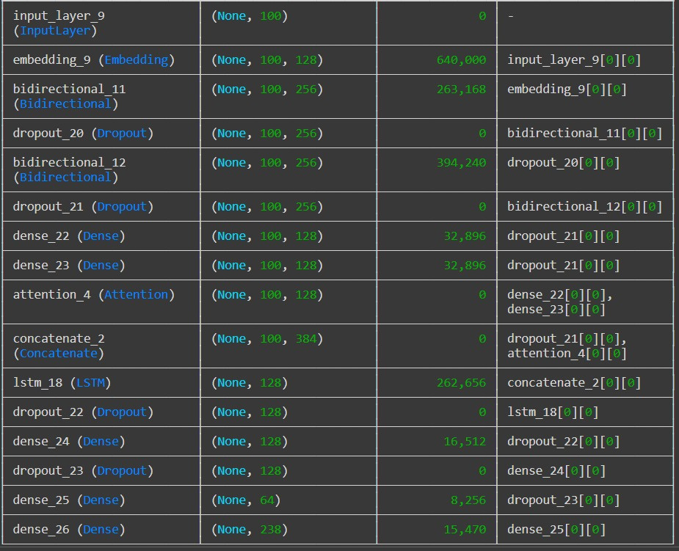
Work Done so far
Fig. 13: Model summary of the LSTM Model (updated dataset)

Slide 31
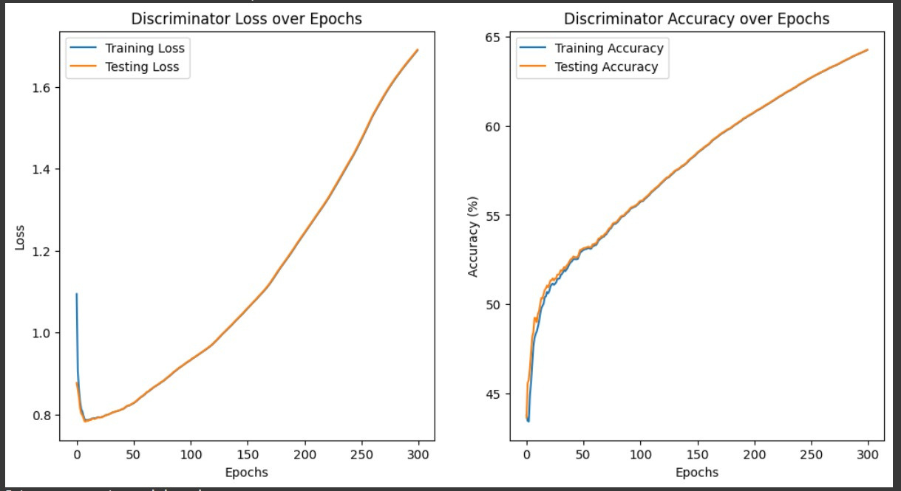
Work Done so far
GAN Model
Fig. 14: Accuracy of the GAN Model

Slide 32
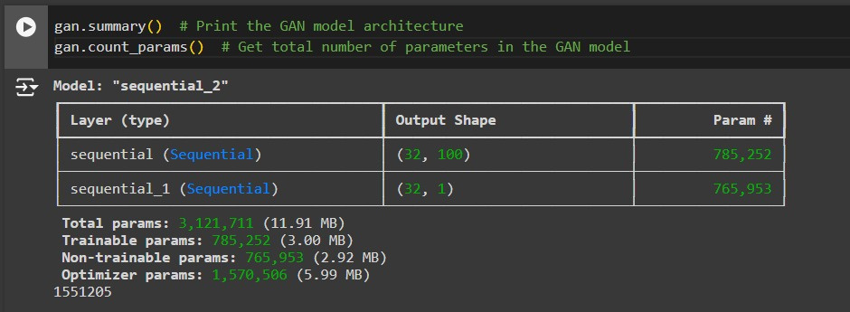
Work Done so far
Fig. 15: Model summary of the GAN Model

Slide 33
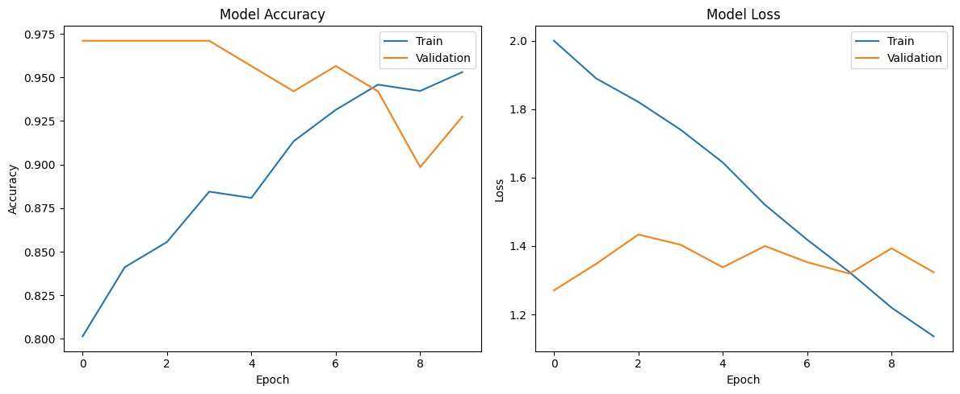
Work Done so far
Hybrid (BiLSTM + BioBERT) Model
Fig. 16: Accuracy of the Hybrid Model

Slide 34
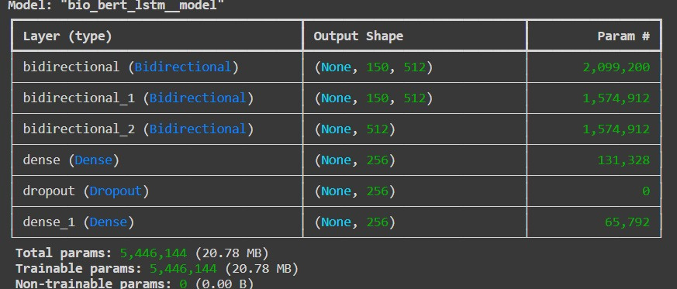
Work Done so far
Fig. 17: Model summary of the Hybrid Model

Slide 35
Work Done so far
Why Hybrid (BiLSTM + BioBERT) Model?
The BioBERT model is a BERT model itself; it especially uses medical terms as its appendix, and hence, it is performing exceedingly well, even more so than the traditional BERT model.
Combined with LSTM layers, it learns patterns specific to our dataset, providing more accurate diagnoses.
GNN, Autoencoder and GAN aren't generally used for sequential text-based data, so they weren't that useful.
T5, while a powerful transformer, is more generalized and not tuned for medical language.

Slide 36
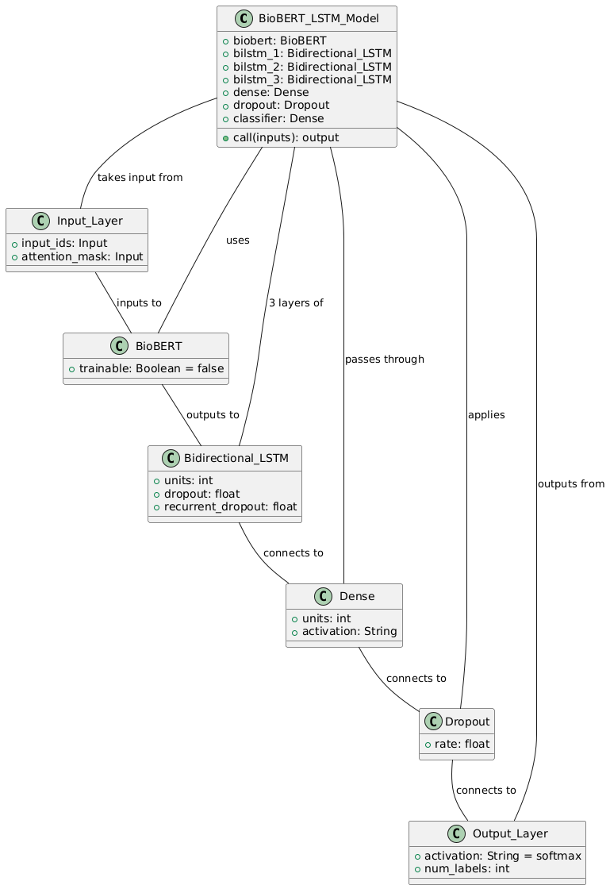
Work Done so far
Model Architecture

Slide 37
Fig. 18: Model Architecture

Slide 38
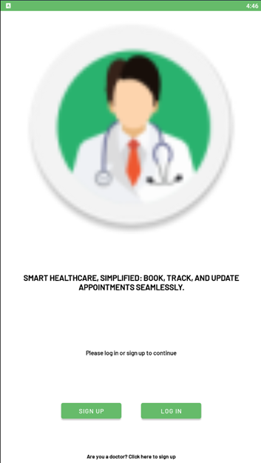
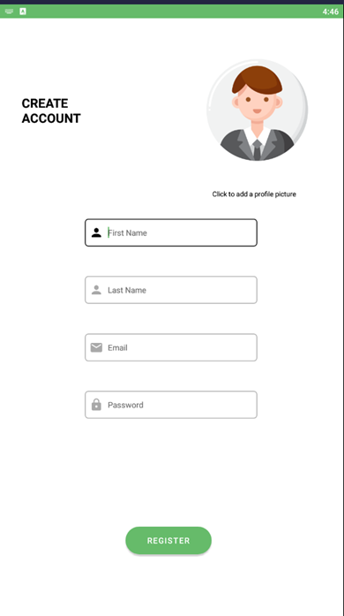
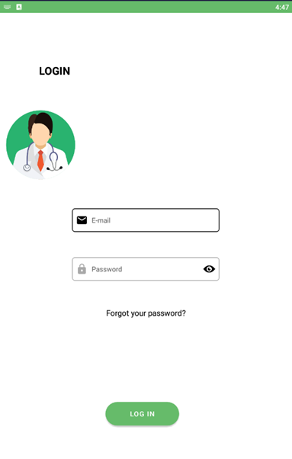
Work Done so far
Fig. 19: Landing Page
Fig. 20: Sign Up Page
Fig. 21: Login Page

Slide 39
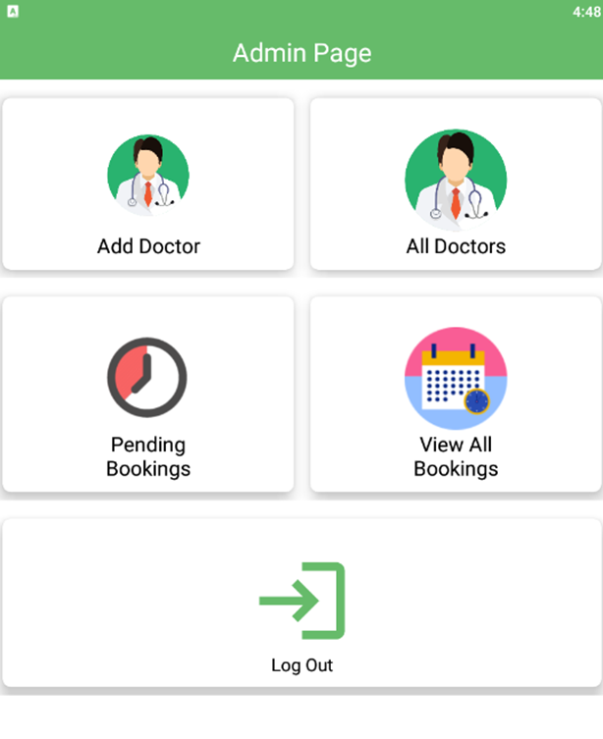
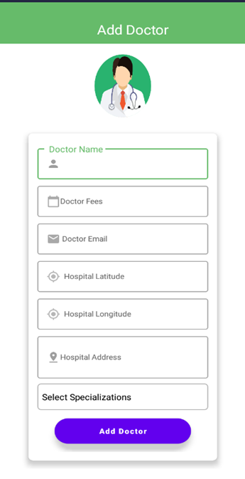
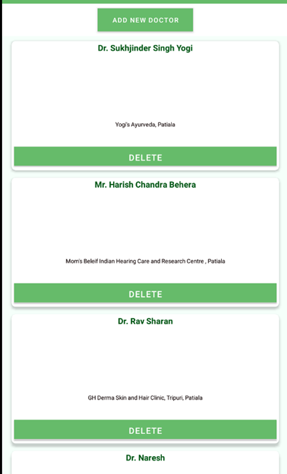
Work Done so far
Admin Functionalities
Fig. 22: Admin Page
Fig. 23: Add Doctor Function
Fig. 24: List of Doctors

Slide 40
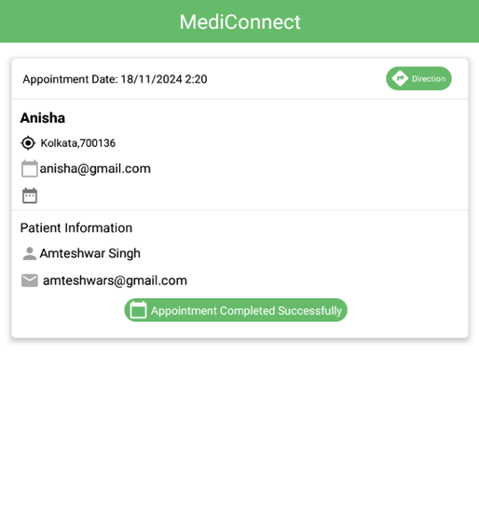
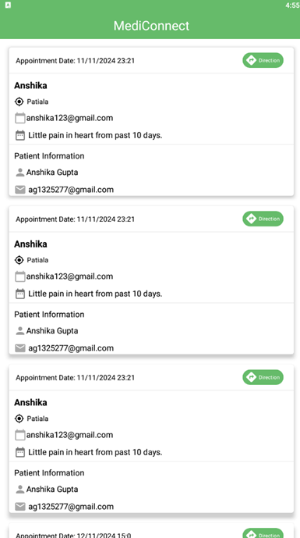
Work Done so far
Admin Functionalities
Fig. 25: View Pending Bookings
Fig. 26: View All Bookings

Slide 41
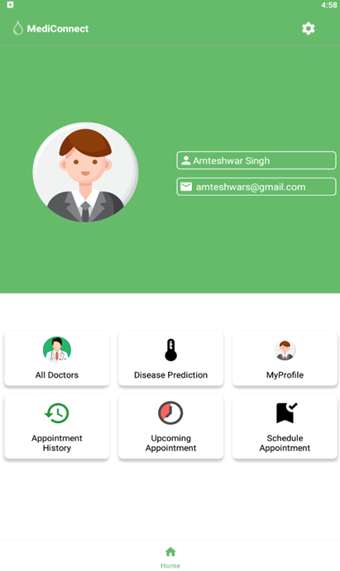
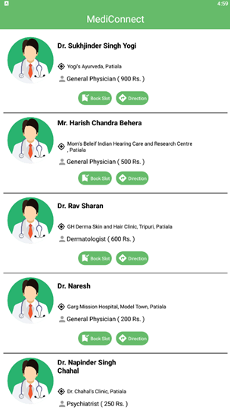
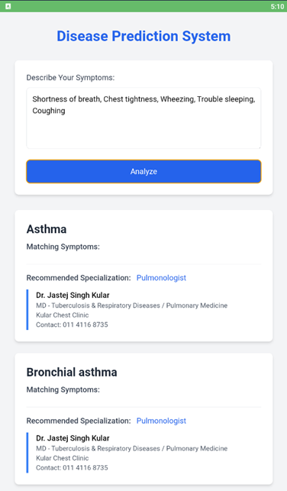
Work Done so far
Patient Functionalities
Fig. 27: Landing Page
Fig. 28: List of Doctors
Fig. 29: Disease Prediction System

Slide 42

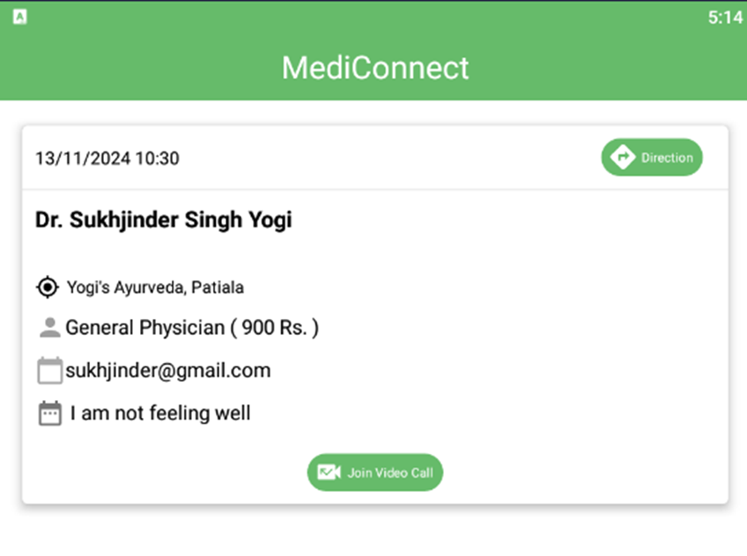
Work Done so far
Patient Functionalities
Fig. 30: Appointment History
Fig. 31: Schedule Appointment

Slide 43
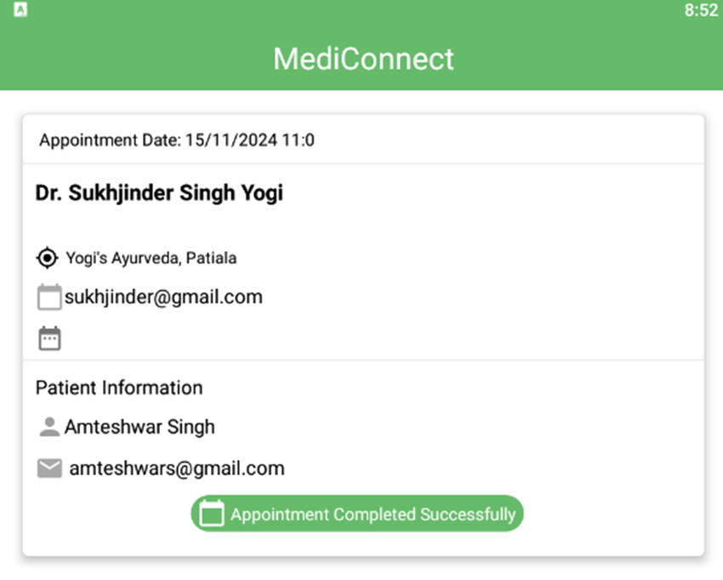
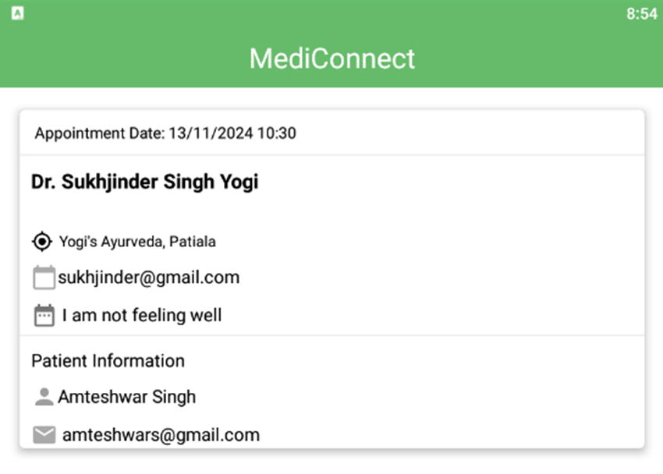
Work Done so far
Doctor Functionalities
Fig. 31: Pending Appointments
Fig. 32: All appointments

Slide 44
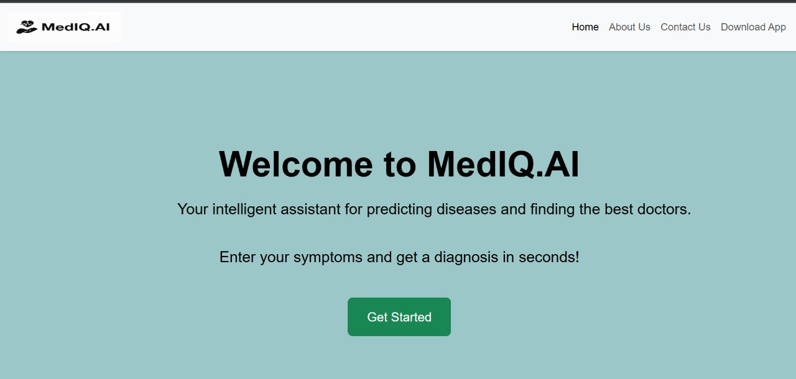
Work Done so far
Website
Fig. 33: Landing Page of Website

Slide 45
References
[1] Agarwal, J., Kumar, M. and Srivastava, A.K., 2021, December. Symptoms based disease diagnosis and treatment recommendation. In 2021 International Conference on Computational Performance Evaluation (ComPE) (pp. 162-167).
[2] Govindaraj, M., Asha, V., Saju, B. and Sagar, M., 2023, January. Machine Learning Algorithms for Disease Prediction Analysis. In 2023 5th International Conference on Smart Systems and Inventive Technology (ICSSIT) (pp. 879-888).
[3] Kumar, R., Pradhan, S., Rebaka, T. and Prakash, J., 2021. Disease prediction from speech using natural language processing and deep learning method. In Congress on Intelligent Systems: Proceedings of CIS 2020, Volume 2 (pp. 407-413).
[4] Zhu, W., Xie, L., Han, J. and Guo, X., 2020. The application of deep learning in cancer prognosis prediction. Cancers, 12(3), p.603.
[5] Yu, Z., Amin, S.U., Alhussein, M. and Lv, Z., 2021. Research on disease prediction based on improved DeepFM and IoMT. IEEE Access, 9, pp.39043-39054.
[6] Chen, M., Hao, Y., Hwang, K., Wang, L. and Wang, L., 2017. Disease prediction by machine learning over bigdata from healthcare communities. IEEE Access, 5, pp.8869-8879.
[7] Gavhane, A., Kokkula, G., Pandya, I. and Devadkar, K., 2018, March. Prediction of heart disease using machine learning. In 2018 second international conference on electronics, communication and aerospace technology (ICECA) (pp. 1275-1278).
[8] Dahiwade, D., Patle, G. and Meshram, E., 2019, March. Designing disease prediction model using machine learning approach. In 2019 3rd International Conference on Computing Methodologies and Communication (ICCMC) (pp. 1211-1215)
[9] Grampurohit, S. and Sagarnal, C., 2020, June. Disease prediction using machine learning algorithms. In 2020 International Conference for Emerging Technology (INCET) (pp. 1-7).
[10] Hema, P., Sunny, N., Naganjani, R.V. and Darbha, A., 2022, April. Disease Prediction using Symptoms based on Machine Learning Algorithms. In 2022 International Conference on Breakthrough in Heuristics And Reciprocation of Advanced Technologies (BHARAT) (pp. 49- 54).

Slide 46
References
[11] Chen, M., Ma, Y., Li, Y., Wu, D., Zhang, Y. and Youn, C.H., 2017. Wearable 2.0: Enabling human-cloud integration in next generation healthcare systems. IEEE Communications Magazine, 55(1), pp.54-61
[12] Mishra, J. and Tarar, S., 2020. Chronic disease prediction using deep learning. In Advances in Computing and Data Sciences: 4th International Conference, ICACDS 2020, Valletta, Malta, April 24–25, 2020, Revised Selected Papers 4 (pp. 201-211).
[13] Maleh, Y., Abd El-Latif, A.A., Curran, K. and Siarry, P. eds., 2023. Computational Intelligence for Medical Internet of Things (MIoT) Applications: Machine Intelligence Applications for IoT in Healthcare. Elsevier.
[14] Usama, M., Ahmad, B., Xiao, W., Hossain, M.S. and Muhammad, G., 2020. Self-attention based recurrent convolutional neural network for disease prediction using healthcare data. Computermethods and programs in biomedicine, 190, p.105191.
[15] Men, L., Ilk, N., Tang, X. and Liu, Y., 2021. Multi-disease prediction using LSTM recurrent neural networks. Expert Systems with Applications, 177, p.114905.
[16] Lalithadevi, B. and Krishnaveni, S., 2022, March. Efficient Disease Risk Prediction based on Deep Learning Approach. In 2022 6th International Conference on Computing Methodologies and Communication (ICCMC) (pp. 1197-1204).
[17] Litjens, G., Kooi, T., Bejnordi, B.E., Setio, A.A.A., Ciompi, F., Ghafoorian, M., Van Der Laak, J.A., Van Ginneken, B. and Sánchez, C.I., 2017. A survey on deep learning in medical image analysis. Medical image analysis, 42, pp.60-88
[18] Rebane, J., Samsten, I. and Papapetrou, P., 2020. Exploiting complex medical data with interpretable deep learning for adverse drug event prediction. Artificial Intelligence in Medicine, 109, p.101942.
[19] https://www.cartertoons.com/

Slide 47


Thank you!

